Slide 1
Car Dealership Management System
Group 3 Members: Pouya Rad Seyed Hossein Sajedi Joshua Luczon

Slide 2
Why designing a car dealership DB
The automotive industry, particularly car dealerships, requires efficient management of vehicle inventory, customer information, and service records. Our involvement with the automotive sector has highlighted the need for an integrated system to streamline operations and enhance customer service. Therefore, our group has chosen to design a database for a car dealership management system. Problem statement: Car dealerships need a centralized database to manage vehicle inventory, track sales transactions, and maintain service records to improve operational efficiency and customer service. Solution: Our team will develop a database to support a car dealership management application. This system will enable the dealership to manage its inventory, track sales and service records, and generate insightful business reports.

Slide 3
Requirements:
User Login/Registration: o Secure user authentication. o Role-based access control.
Vehicle Inventory Management: o Vehicle details (make, model, year, VIN, color, price). o Vehicle status (available, sold, under maintenance).
Customer Management: o Customer profiles (contact information, purchase history, service history).
Sales Management: o Sales transactions (vehicle sold, sales date, sales representative, price, payment method).
Service Records: o Service appointments and history (vehicle, customer, service details, date, cost).
Reporting: o Inventory reports (current inventory, sold vehicles). o Sales reports (monthly sales, sales by representative). o Customer reports (demographics, purchase history). o Service reports (service activity, revenue from services).

Slide 4
Tables: 1.Sales
PK saleID
saleDate
FK customerID (Customer.CustomerID)
FK VIN (Vehicles.VIN)
FK salesRepNumber(Employees. employeeID)
totalPrice
paymentMethod
A car dealership contains many vehicles. The dealership employs many sales representatives.
Each sales representative can handle multiple sales, but a sale is handled by only one sales representative. Sales representatives work for the dealership and do not belong to any specific department.

Slide 5
Customer
PK customerID
customerName
custPhone
custEmail
custPhone
FK custVIN(Vehicles.VIN)
Each vehicle can be sold to a customer.
A customer can purchase multiple vehicles, but each vehicle can be sold to only one customer.
Customers can schedule service appointments for their vehicles. A customer can have multiple appointments, but an appointment is for only one customer.

Slide 6
Employees
PK employeeID
employeeName
empEmail
empPhone
jobTitle
FK supervisorID(Employees.employeeID)
Employees of the dealership can have supervisors.
A supervisor can supervise multiple employees, but each employee has only one supervisor.

Slide 7
Vehicles
PK VIN
make
model
vehiclePrice
color
status
A vehicle can be serviced in multiple appointments, but each appointment is for only one vehicle.

Slide 8
Appointments
PK appointmentID
appointmentDate
FK customerID (Customer.CustomerID)
FK VIN(Vehicles.VIN )
FK serviced(Services.ServiceID)
Each service can be part of many appointments, but an appointment involves only one service

Slide 9
Services
PK serviceID
serviceDescription
servicePrice

Slide 10
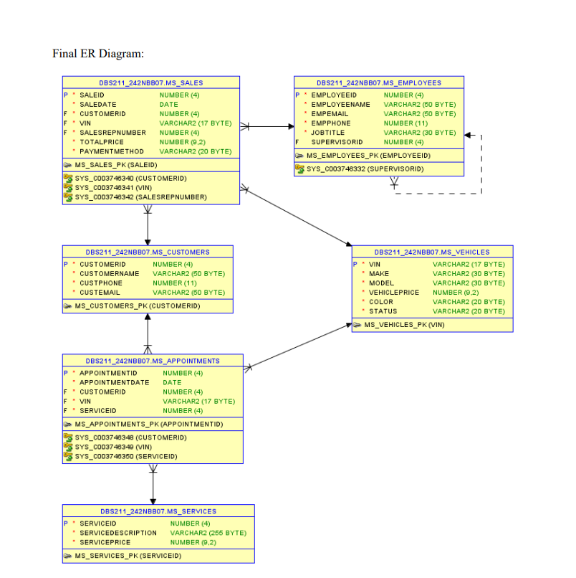

Slide 11
Views(virtual tables) to access data faster
1.VIEW CustomerServiceAppointments = SELECT C.customerName, A.appointmentDate, S.serviceDescription, S.servicePrice, C.custVin FROM Appointments A JOIN Customer C JOIN CustomerService S
2.VIEW MonthlySalesReport = SELECT saleDate(in date data type AS Month, SUM(totalPrice) AS MonthlySales FROM Sales GROUP BY saleDate in year and month format

Slide 12
Thank you

